Slide 2
Before we get started
We are recording the sessions
Please mute your microphone
Please type your comments and questions into the chat
You can also come out of mute to ask a question or make a comment
Raise your hands in Teams, but this is harder for the presenter to see.

Slide 3
App roles and groups

Slide 4
Demo Enterprise App Users and Groups

Slide 5
Application roles are used to assign permissions to users and apps.
They are specific to an application. Thus, removing an app from AAD will make these roles go away.
They are provided to an app in the roles claim.
App Roles

Slide 6
How it works
Define app roles in an application’s manifest.
Assign roles to users and security groups or apps
Receive assigned roles in the user’s or app’s token in the roles claim

Slide 7
App Roles assigned to Users
http://aka.ms/approles

Slide 8
App Roles for Users
Define app roles that will be assigned to users in a tenant
Developers write code for role permissions in their app
The user assignment is usually done by members of the IT team than developers themselves.
Will only be present in tokens if a user signs in
How to: Add app roles in your application and receive them in the token

Slide 9
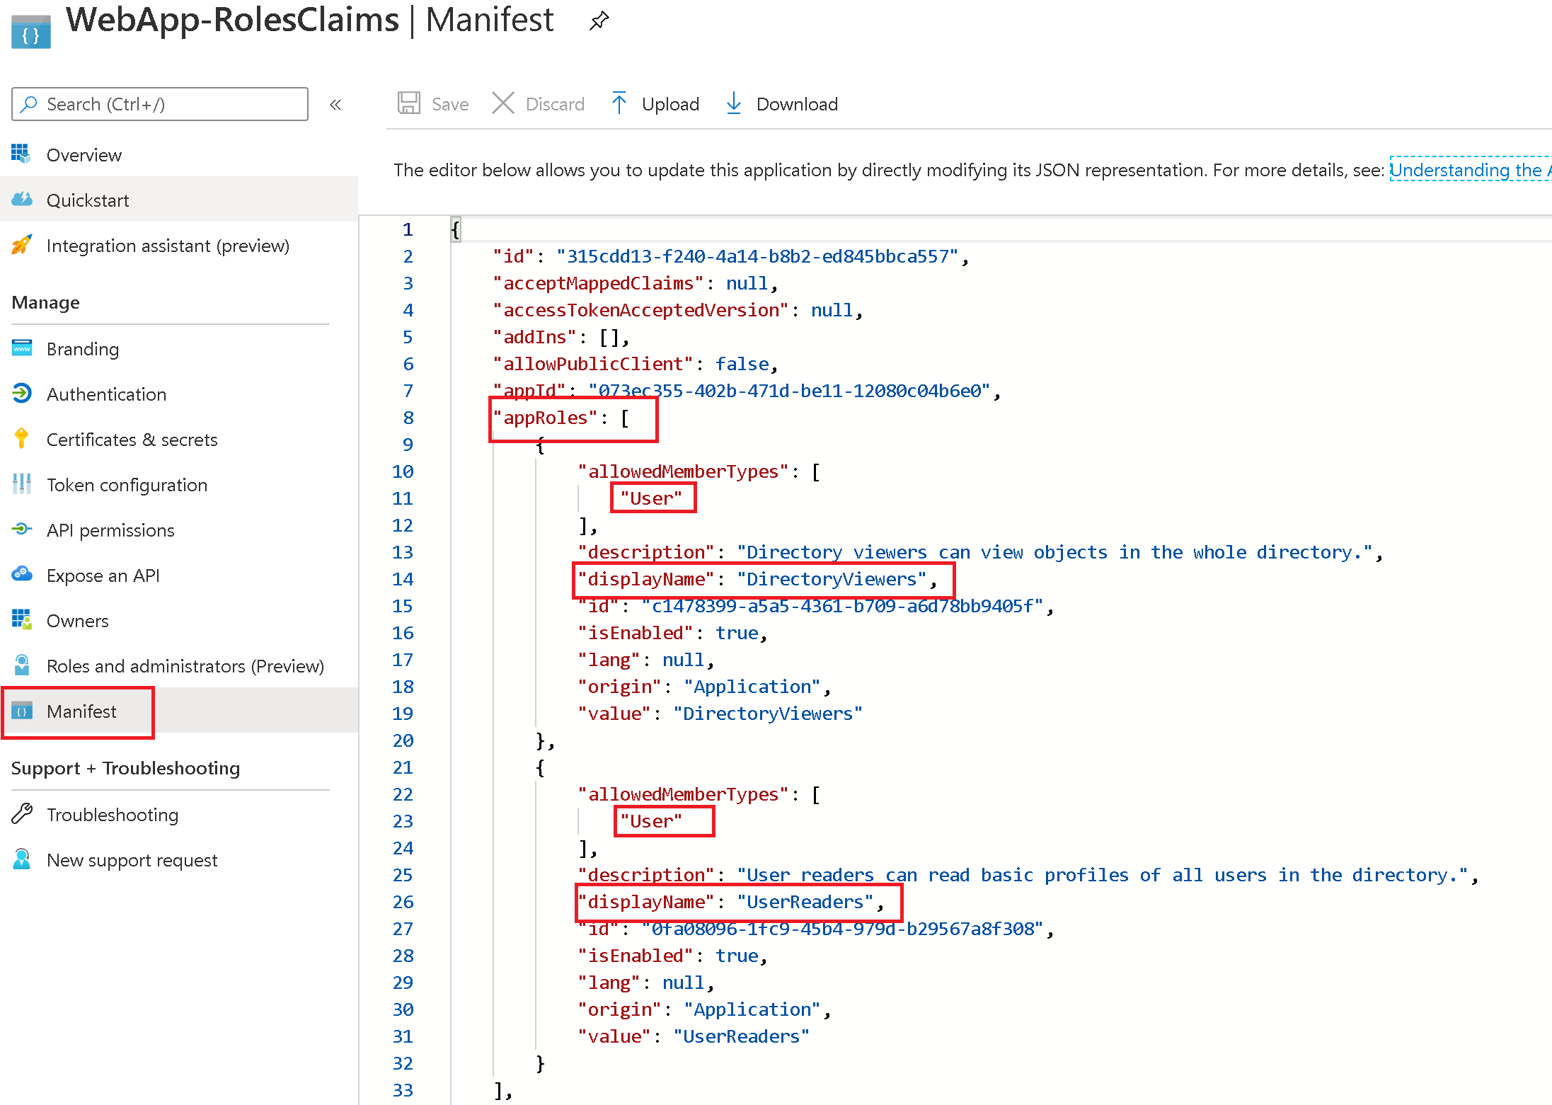
Declare roles in App Manifest
App roles for users

Slide 10
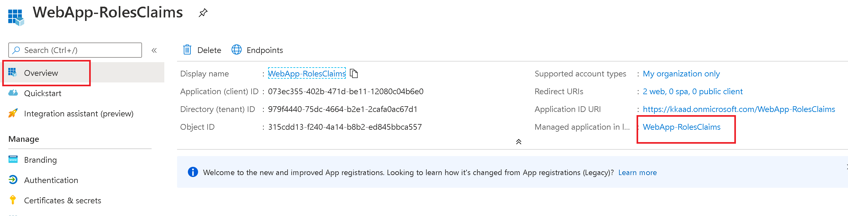
Assign users and groups to roles

Slide 11
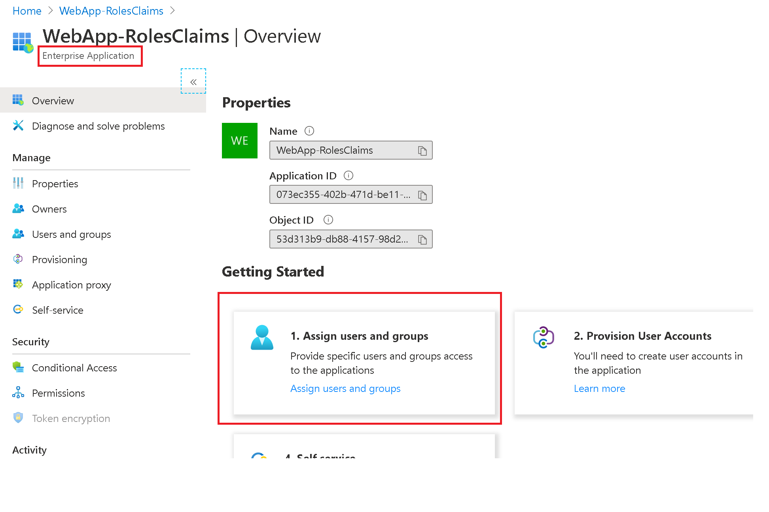
Assign users and groups to roles

Slide 12
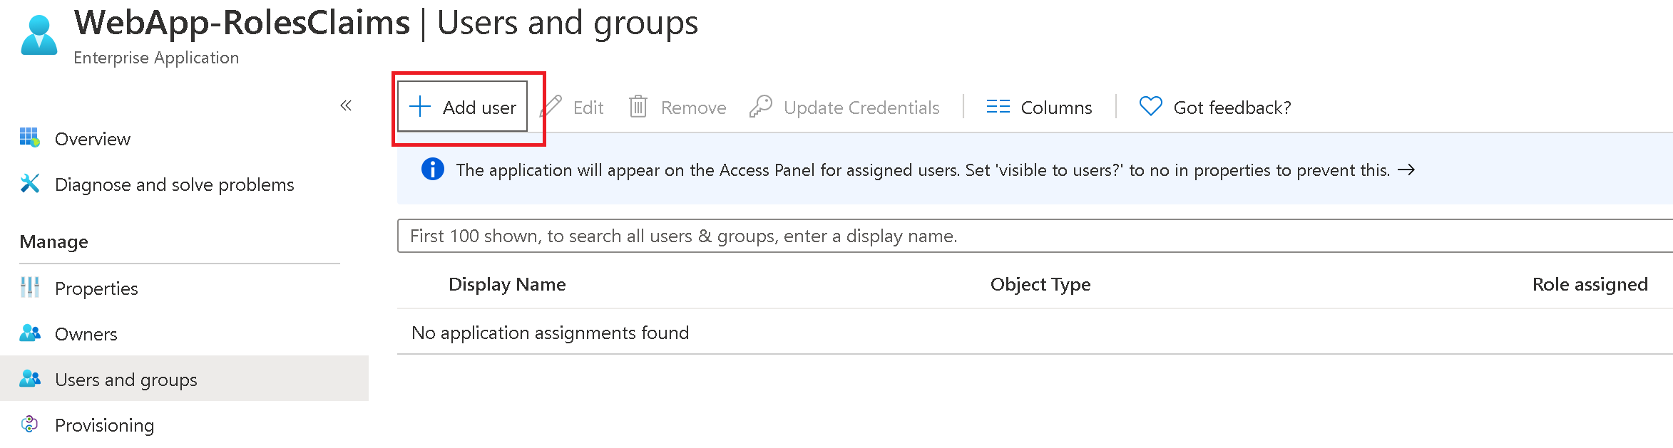
Assign users and groups to roles
Assign a user or group to an enterprise app in Azure Active Directory

Slide 13
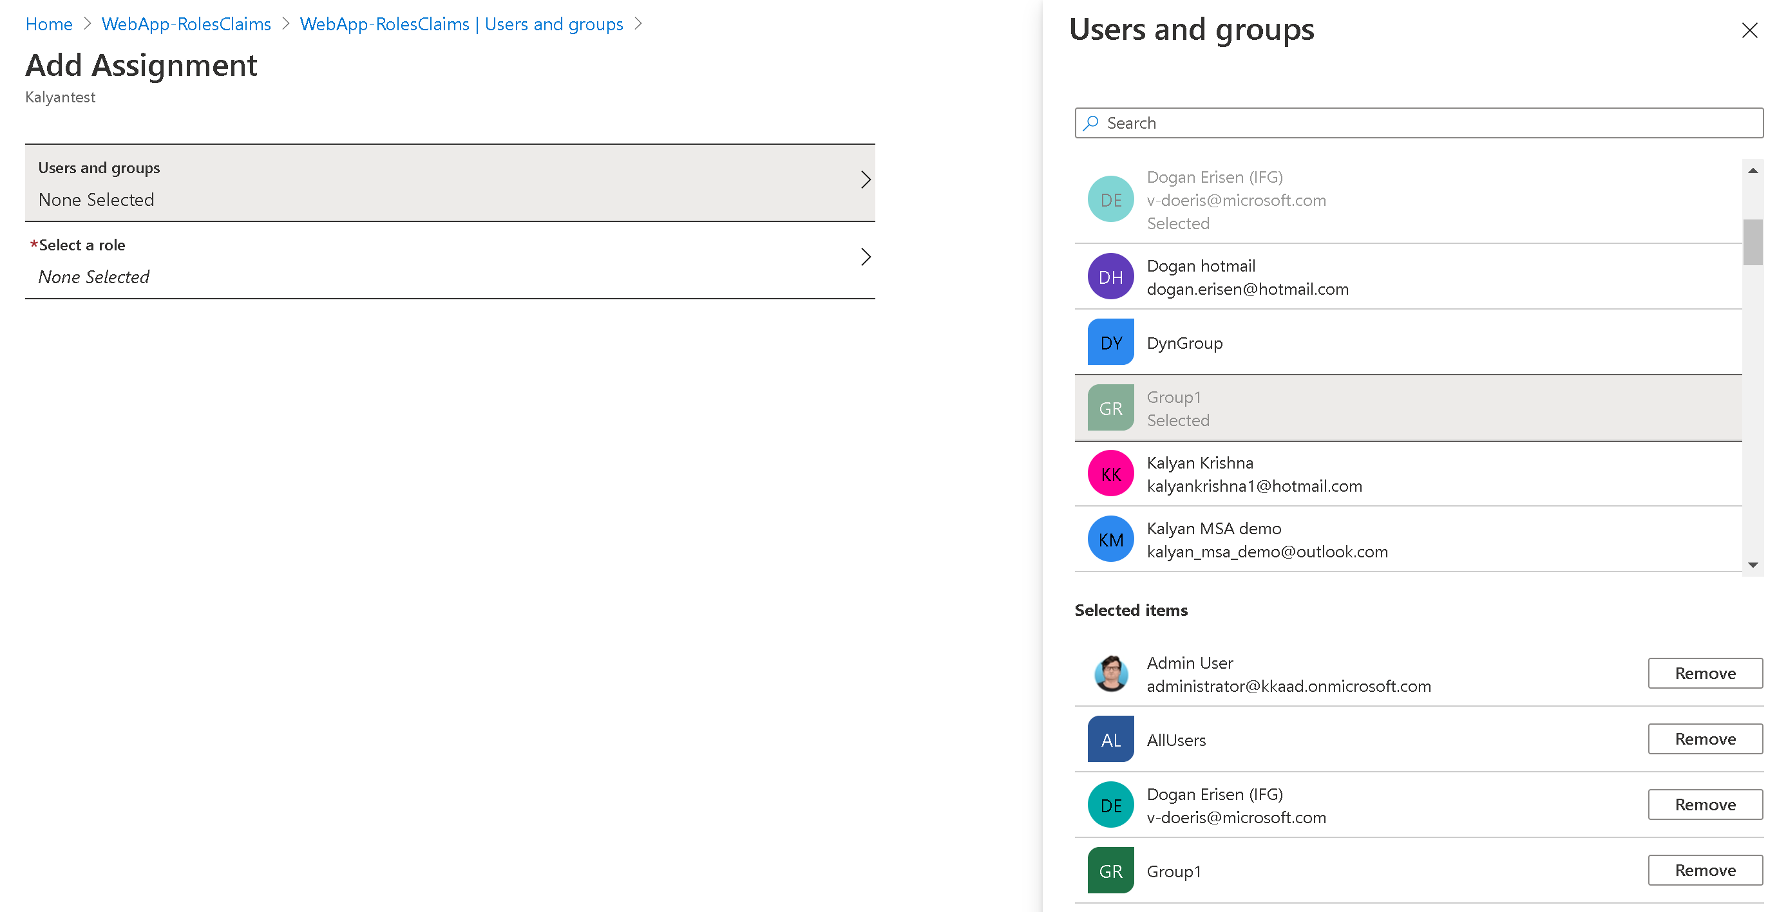
Assign users and groups to roles

Slide 14
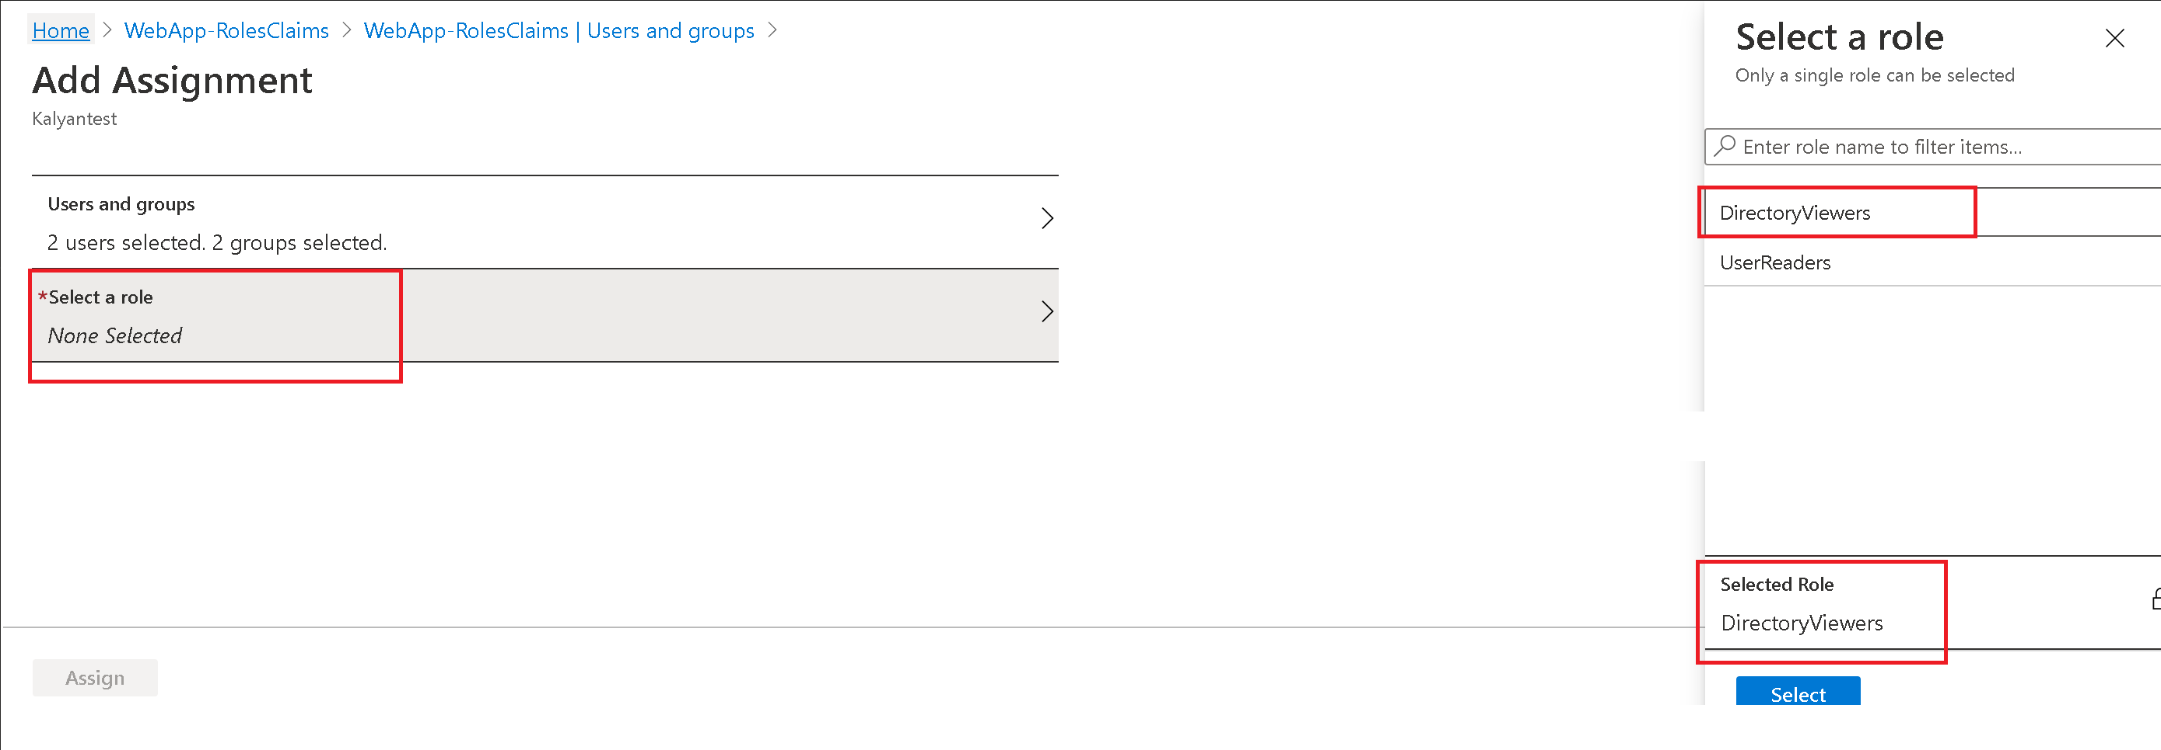
Assign users and groups to roles

Slide 15
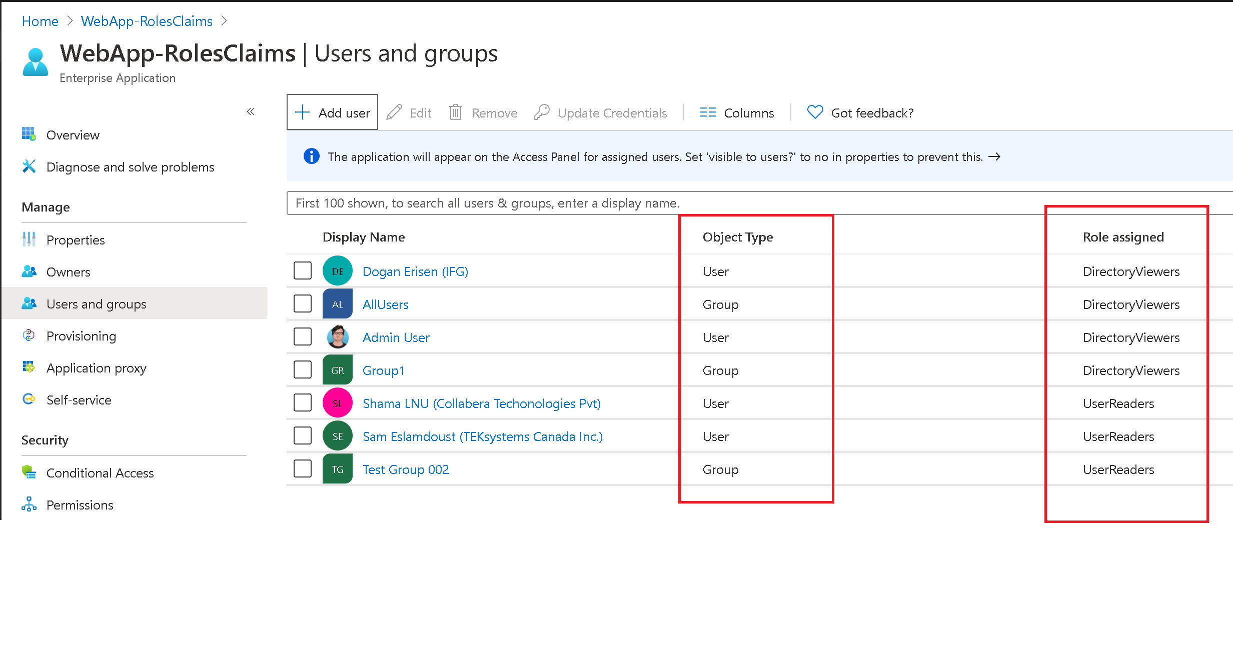
Assign users and groups to roles

Slide 16
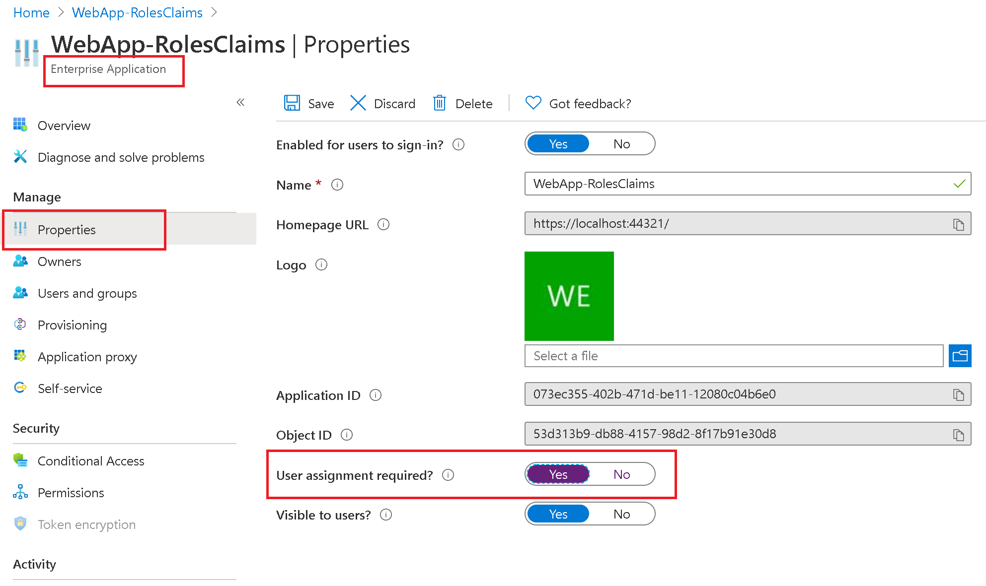
Assign users and groups to roles

Slide 17
Id_token with groups and roles
App roles for users
Roles in a token will be provided in the “roles” claim
{
"aud": "300e33f5-e62e-4581-acd2-542ece0965cc",
"iss": "htps://login.microsoftonline.com/536279f6-15cc-45f2-be2d-61e352b51eef/v2.0",
"iat": 1563969244,
"nbf": 1563969244,
"exp": 1563973144,
"aio": "AeQAG/8MAAAAYPOQy4ROQXwGbt+LpH37Q8I=",
"groups": [
"MSDemoUsers"
],
"name": "Kalyan Krishna",
"nonce": "6369956633167913NDUwODI0",
"oid": "98d51ac8-a756-43ef-876f-e7e64c89b323",
"preferred_username": "kkrishna@contosoorg.net",
"roles": [
"DirectoryViewers"
],
"sub": "bGcfwO94xuVM7Dv-O62Bb76ZlB9RzHa0R-48jtQgKgg",
"tid": "536279f6-15cc-45f2-be2d-61e352b51eef",
"uti": "WQBn7mDb2UygvE7fPrIfAA",
"ver": "2.0"
}

Slide 18
App Roles for Users
Using App roles limits the amount of information that needs to go into the token, is more secure, and separates user assignment from app configuration.
There is no explicit limit to number of app roles that can be declared for an app registration. The limit is imposed by the total number of entries of all the collections in the manifest, which is combined at 1200.
Their memberships are managed by app owners or users in the app admin roles.
When assigning groups to app roles, note that, nested group memberships are not supported (yet).
Use Microsoft Graph’s appRoleAssignment API to programmatically manage role memberships

Slide 19
Security Groups

Slide 20
Security Groups
A Security Group is a collection of users assigned to the group. Rights are assigned to them.
These groups can be cloud-only or sync’d from on-premise.
Not tied to an app, security groups can be used in multiple apps and for other access control purposes.

Slide 21
How it works
Users are assigned to security groups by tenant admins or IT staff (usually).
Developers code for a group’s permissions in their app.
Enable group claims for your app in the App registration portal.
Use these group ids or names provided in the token in your code to lookup assignments.

Slide 22
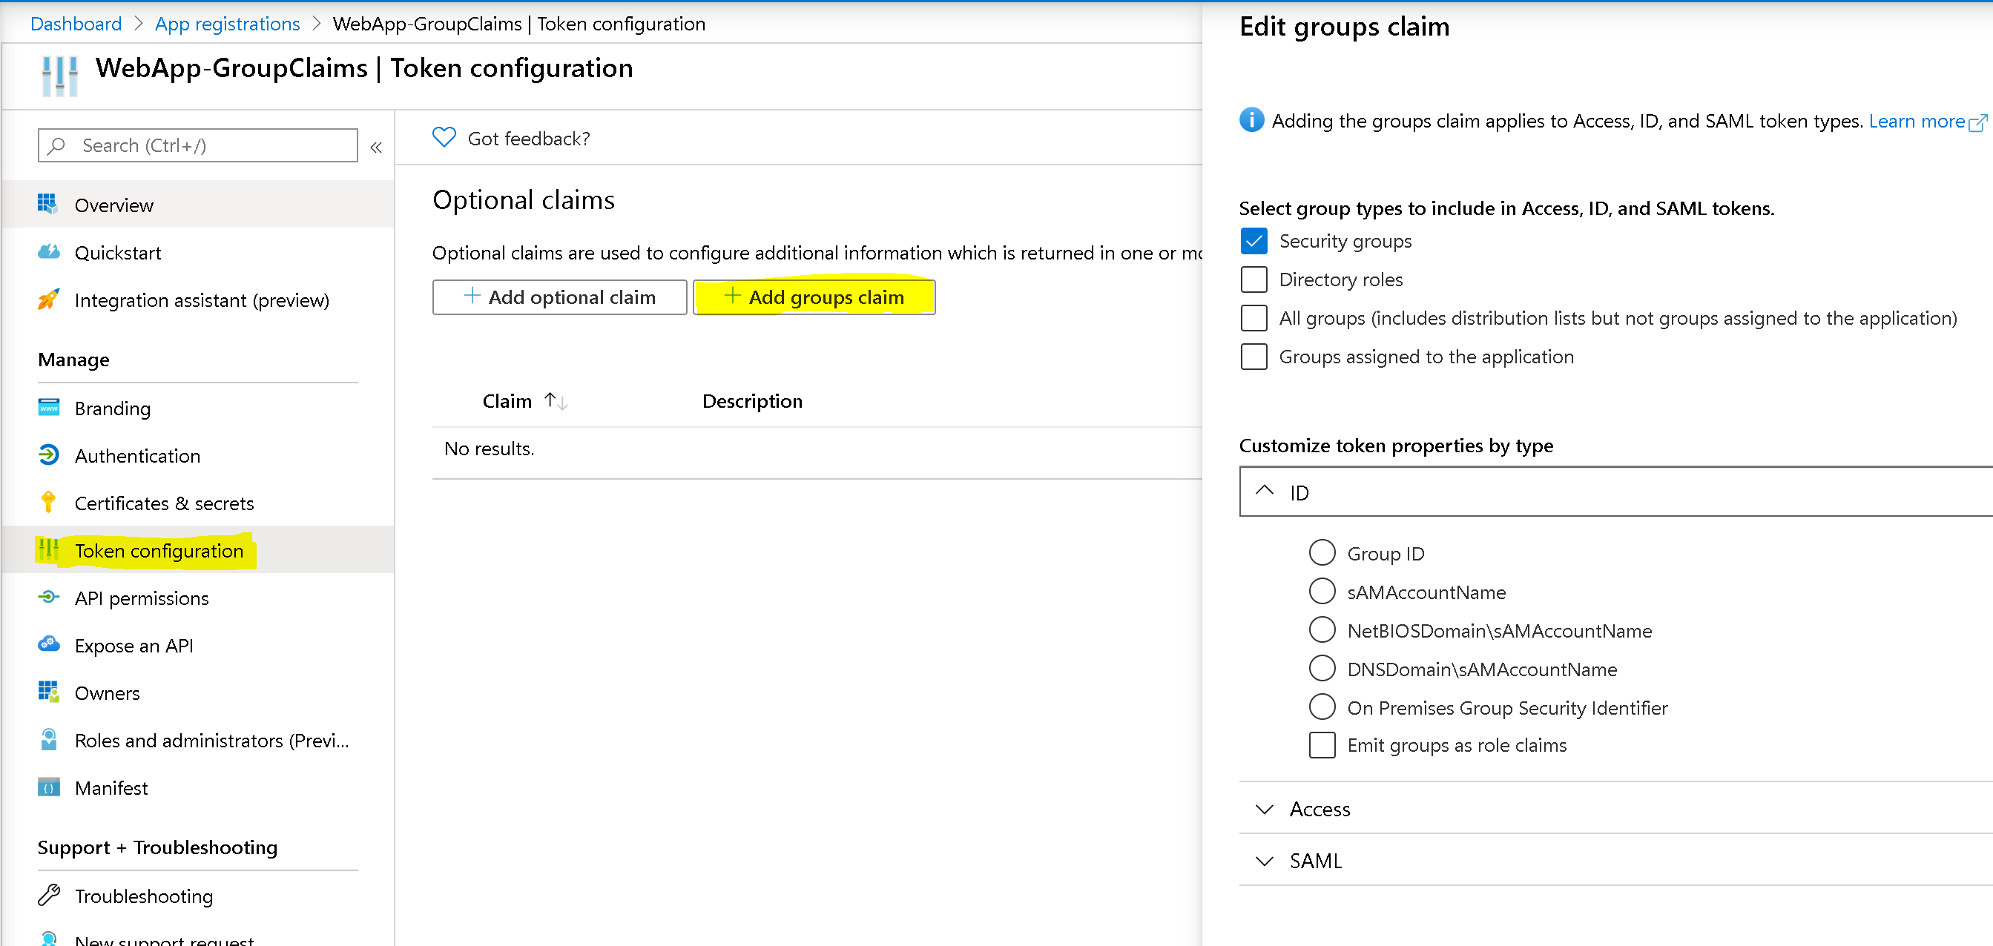
Changes to app registration
None
Security groups
Including nested groups !
Directory roles
All Groups
Security Groups
Distribution Lists
Directory roles
Groups assigned to the application
You choose the groups you want !

Slide 23
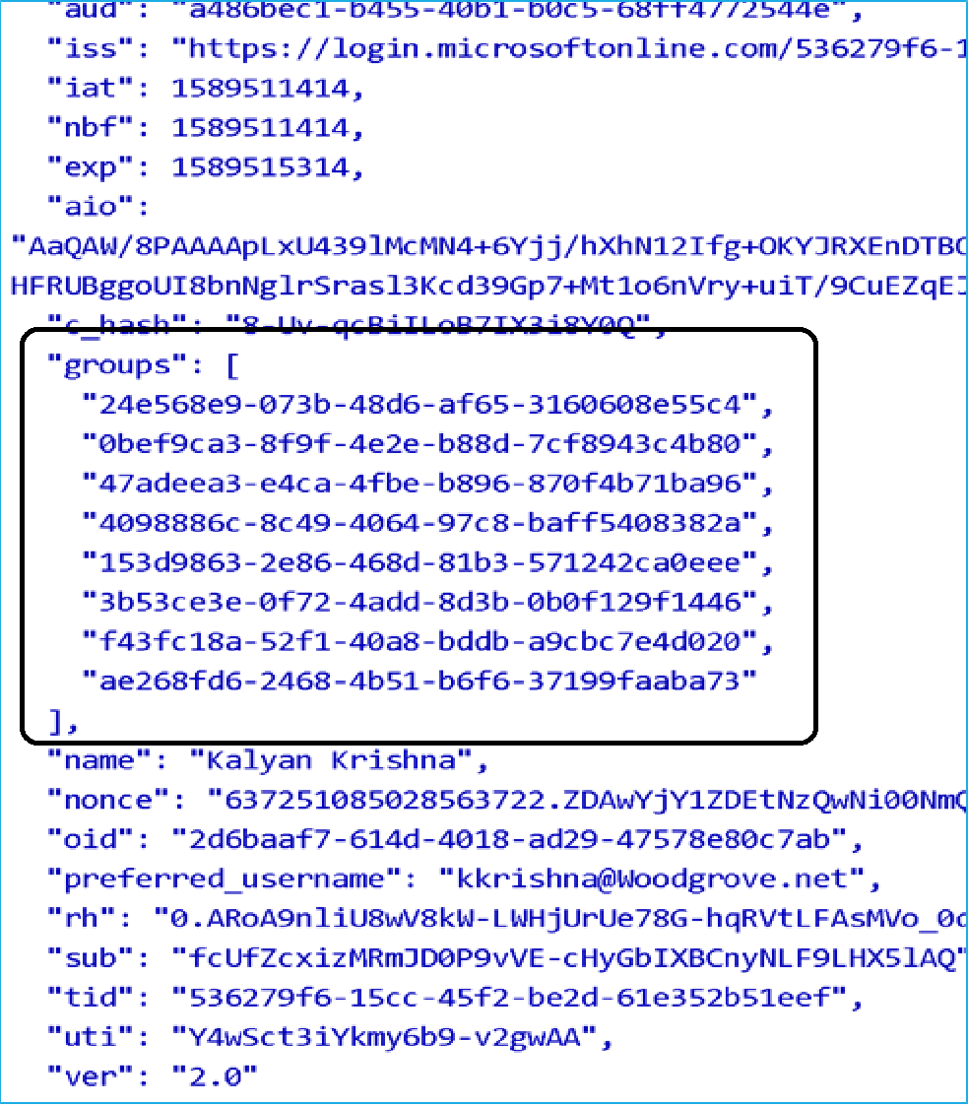
A token with group ids

Slide 24
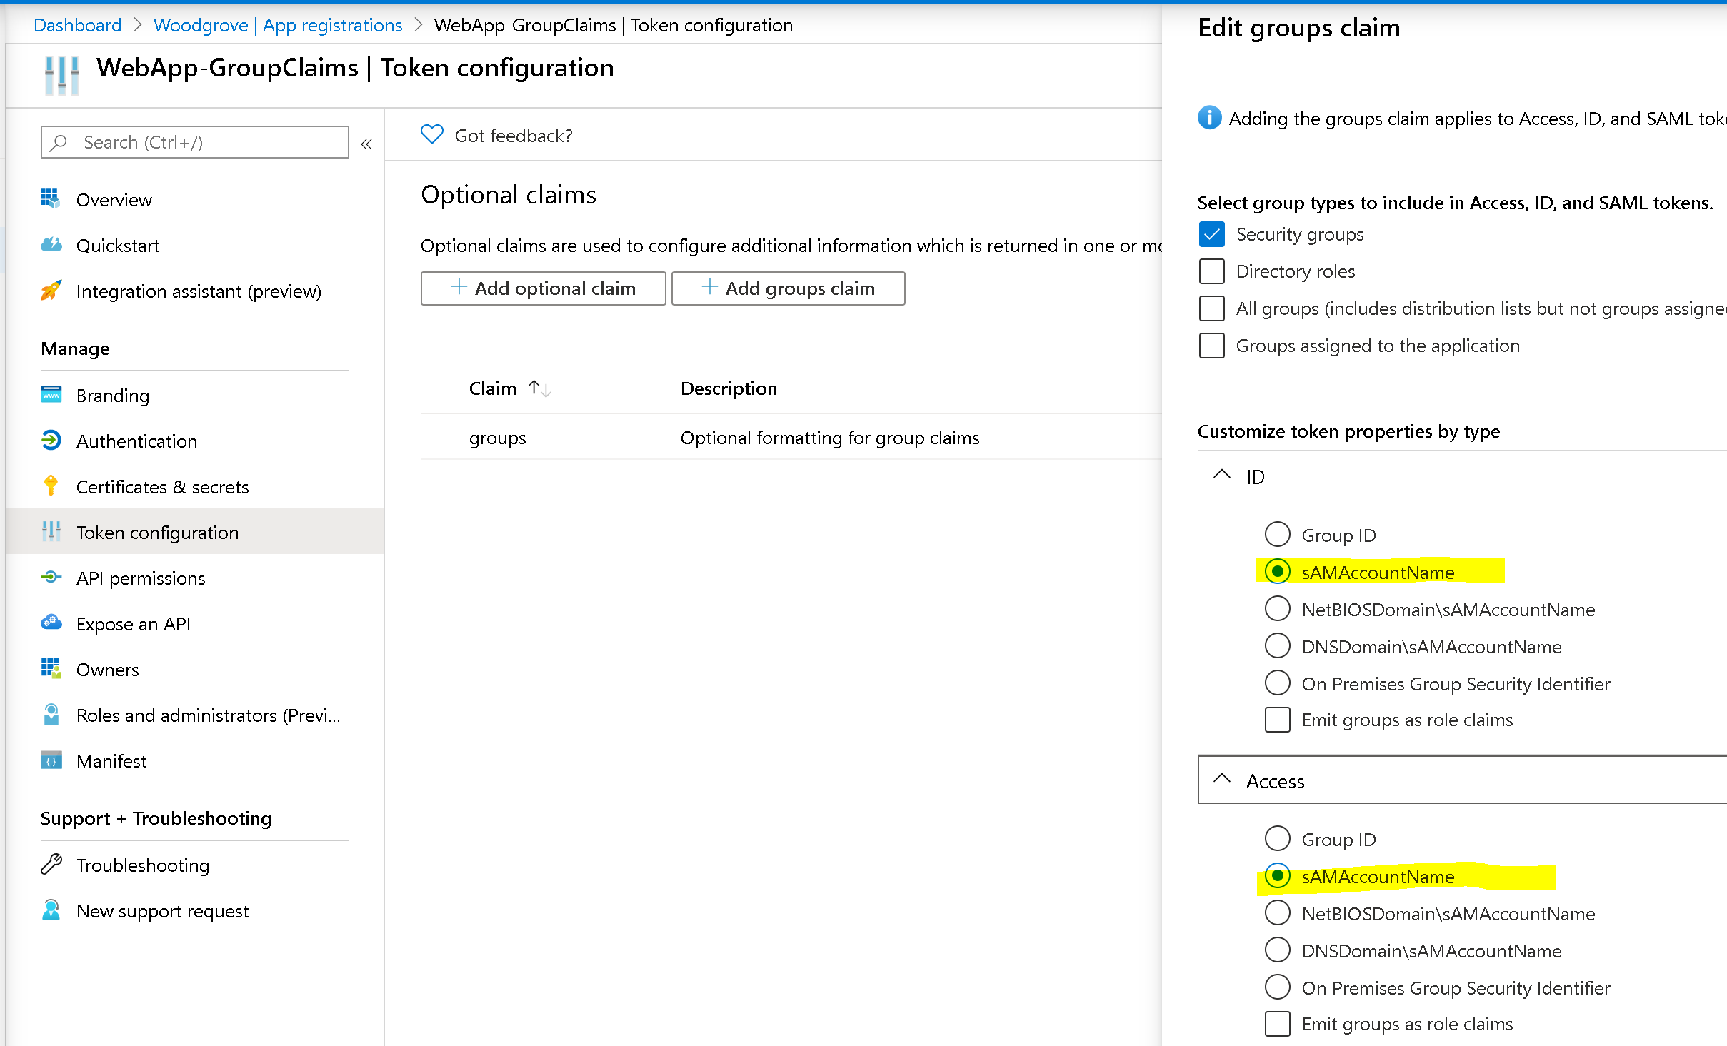
Let’s get group names instead
By default , Group Ids will be emitted in the group claim value.
Valid options are : "sam_account_name", “dns_domain_and_sam_account_name”, “netbios_domain_and_sam_account_name”, "emit_as_roles"
Works for on-prem groups only
Configure group claims for applications with Azure Active Directory

Slide 25
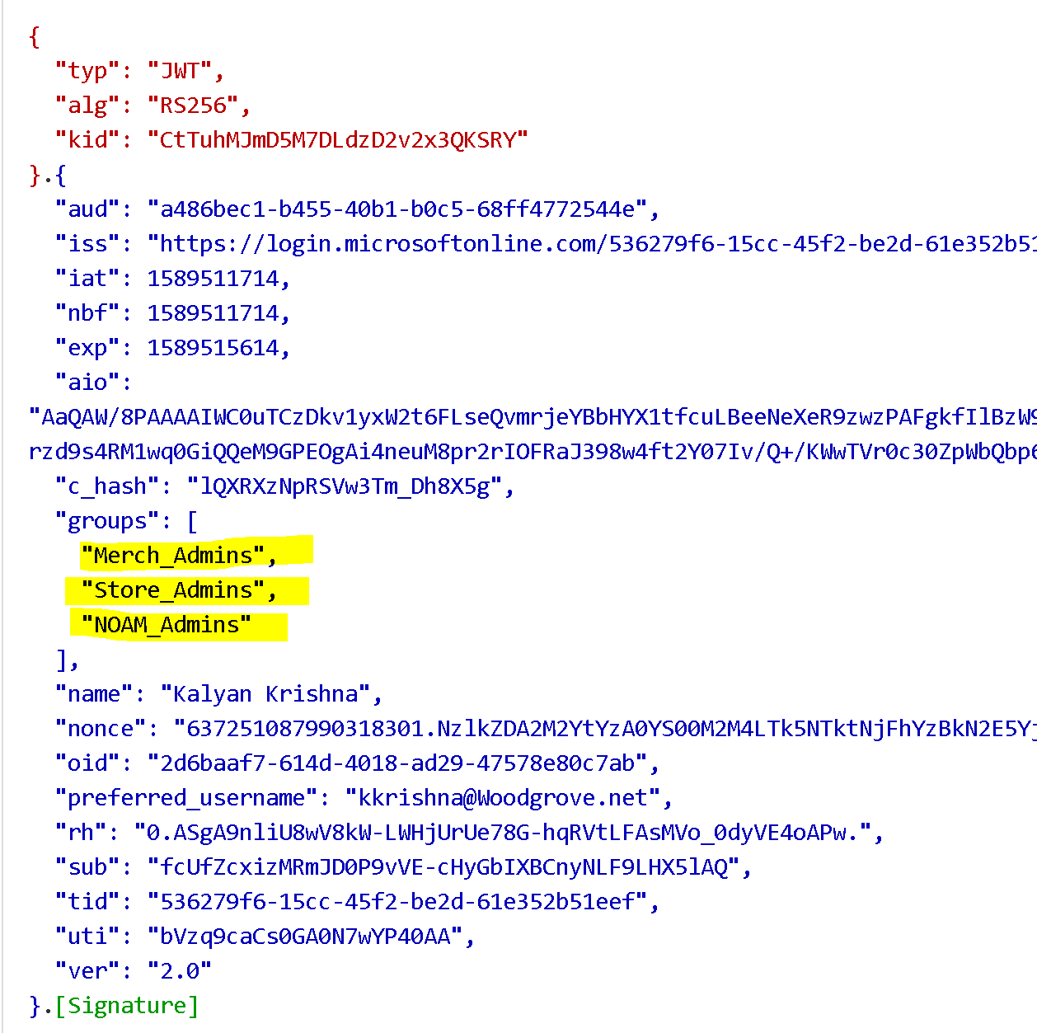
A token with group names

Slide 26
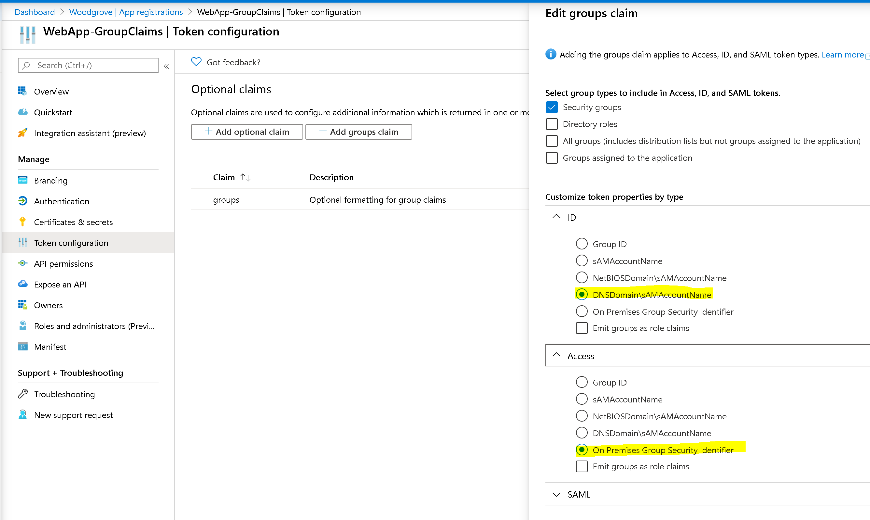
Let’s get group names instead – another setting

Slide 27
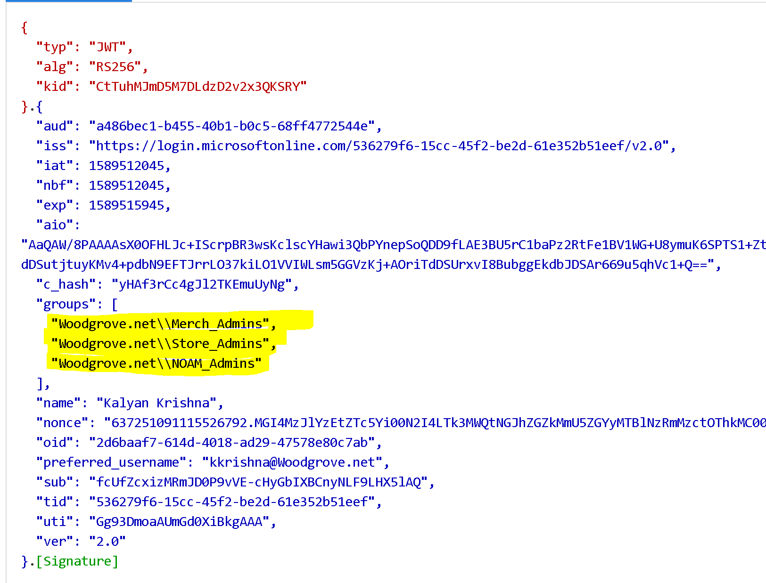
A token with group names

Slide 28
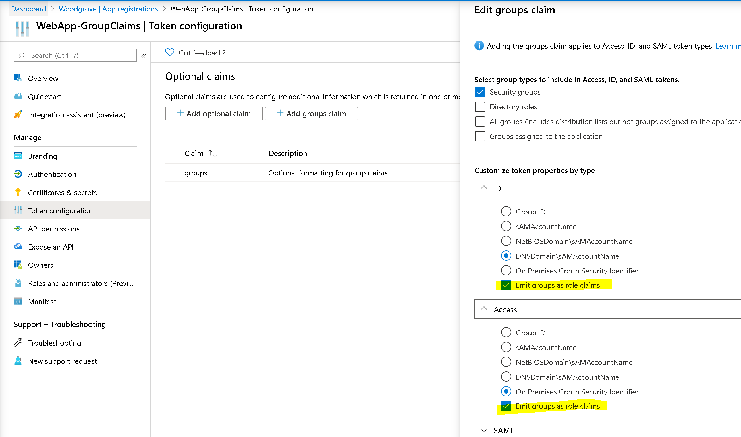
Emit as ‘roles’ claim (only works for security groups)

Slide 29
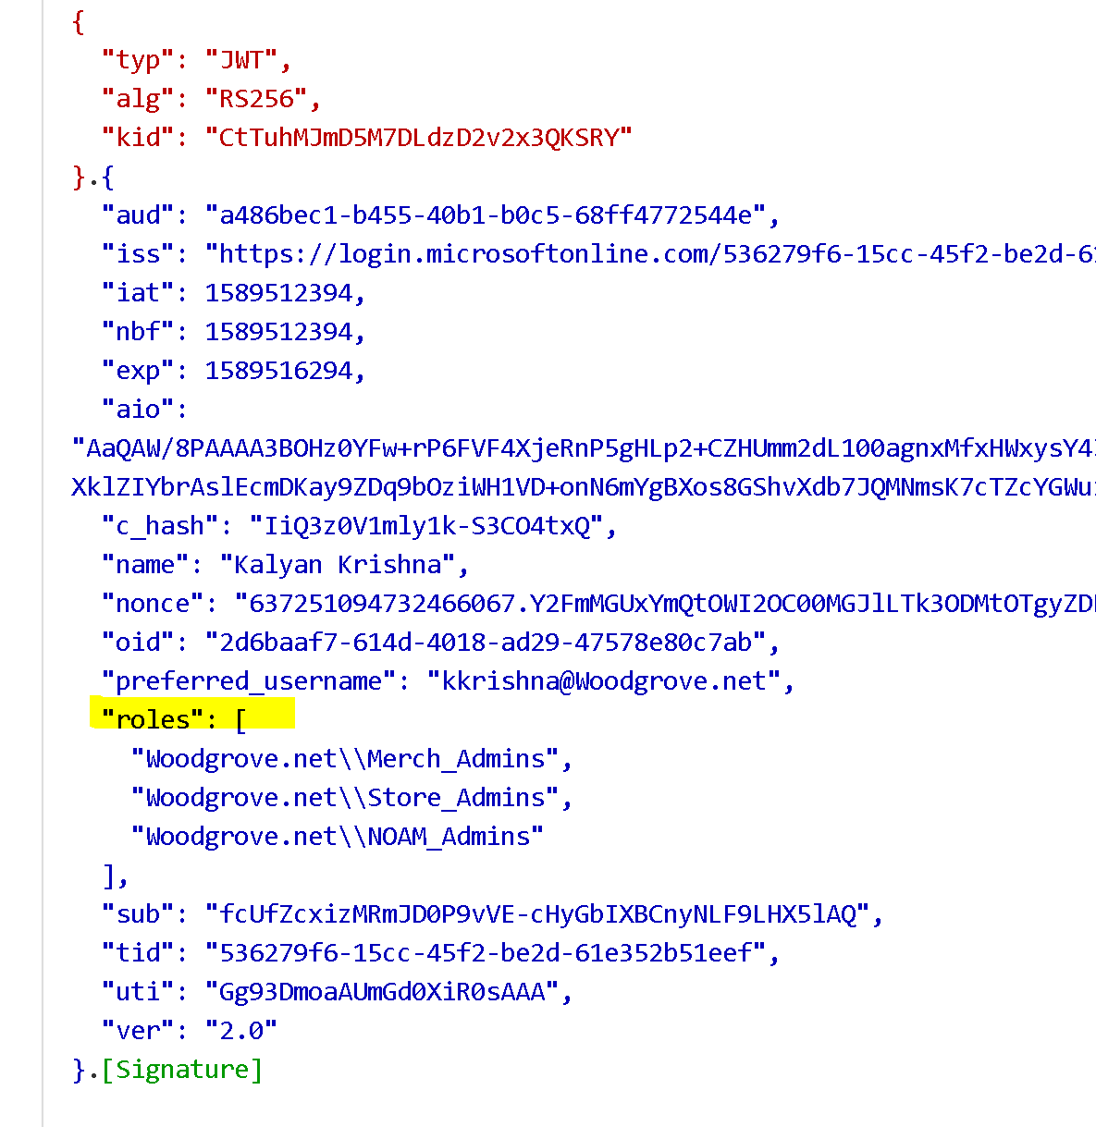
A token with groups in roles claim

Slide 30
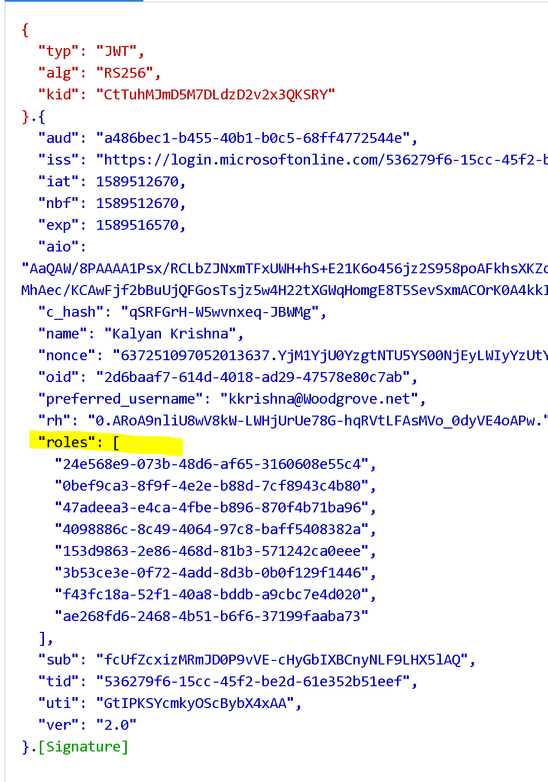
A token with group ids in ‘roles’ claim

Slide 31
Groups claims
Different features for cloud-only and on-prem groups
Supports nested groups. Group claims in tokens include nested groups except when using the option to restrict the group claims to groups assigned to the application (Application Groups)
Groups and their memberships can be managed by the group owner and several Azure AD admin roles, and the lifecycle is not controlled by the app.
If the option to emit group data as roles is used, only groups will appear in the role claim. Any Application Roles the user is assigned will not appear in the role claim

Slide 32
Nested Groups

Slide 33
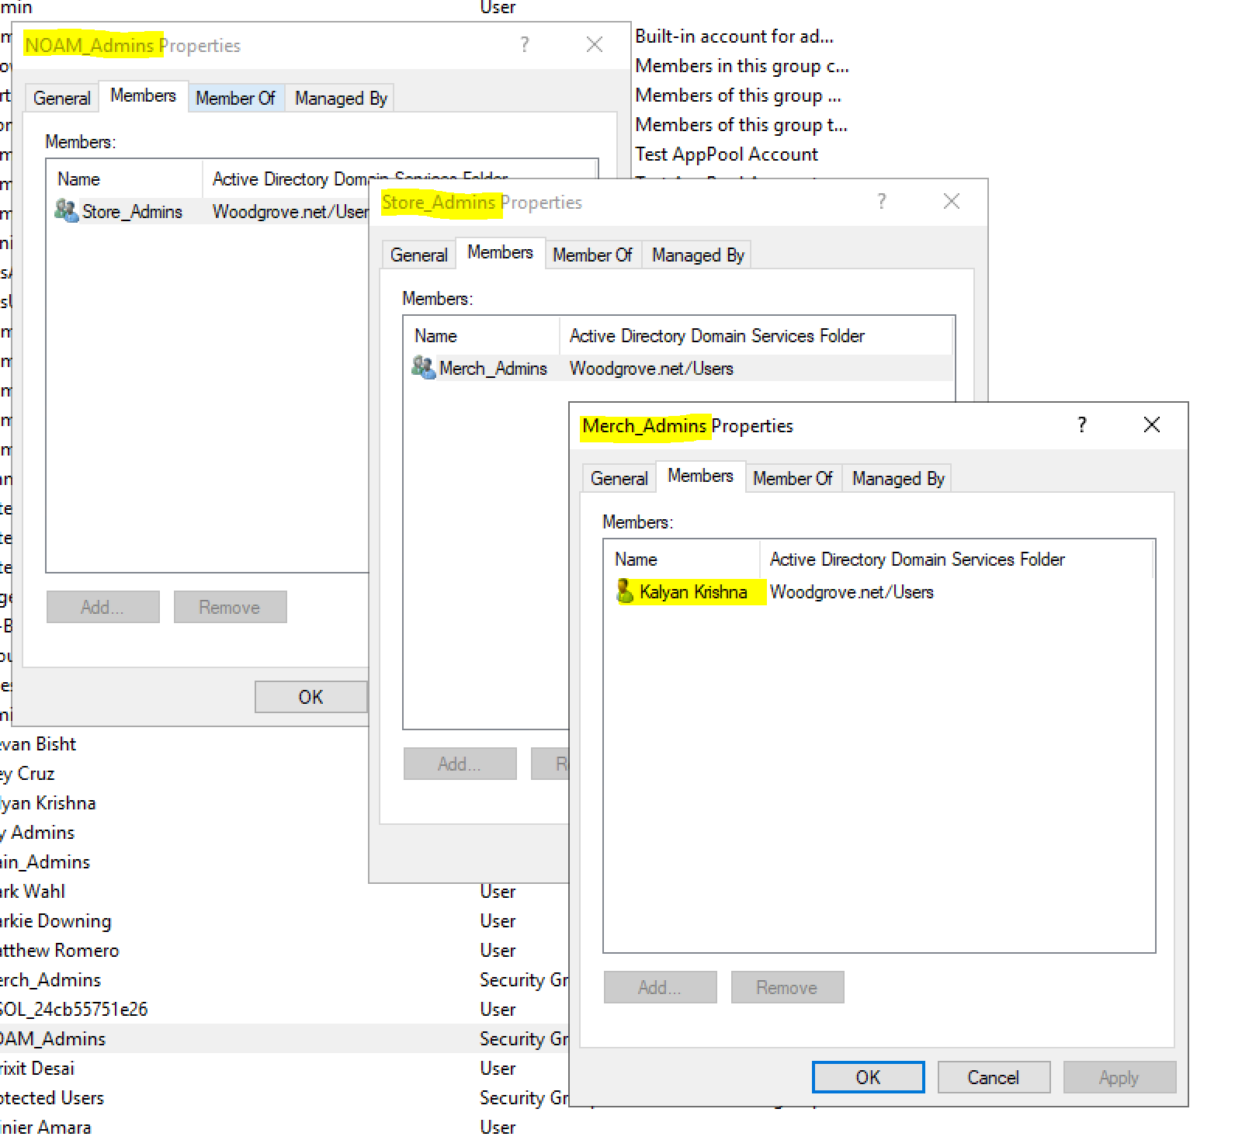
Nested groups

Slide 34

A token with nested group Ids !
{ "aud": "300e33f5-e62e-4581-acd2-542ece0965cc", "iss": "https://login.microsoftonline.com/536279f6-15cc-45f2-be2d-61e352b51eef/v2.0", "iat": 1563951027, "nbf": 1563951027, "exp": 1563954927, "aio": "AbQAS/kYfVrGv9e4mokkd6rh9bzAhaLagwT8xA/fQ=", "groups": [ "24e568e9-073b-48d6-af65-3160608e55c4", "0bef9ca3-8f9f-4e2e-b88d-7cf8943c4b80", "153d9863-2e86-468d-81b3-571242ca0eee", "78b38262-73ee-4781-99cd-f4ba40ff2faa", "1bfd0ed3-f78f-4cf6-9c4f-8828f48a588a", "5a3ced6e-3a38-4533-b519-23b8cdf7dc34" ], "name": "Kalyan Krishna", "nonce": "63699548079517M2MxYzk4MjU4ZDhk", "oid": "98d51ac8-a756-43ef-876f-e7e64c89b323", "preferred_username": "kkrishna@contosoorg.net", "sub": "bGcfwO94xuVM7Dv-O62Bb76ZlB9RzHa0R-48jtQgKgg", "tid": "536279f6-15cc-45f2-be2d-61e352b51eef", "uti": "trxUTCOASkO3HfHwr6gUAA", "ver": "2.0" }

Slide 35
Let’s get group names instead

Slide 36
Let’s get group names instead – another setting

Slide 37
A token with group names

Slide 38
Nested Groups
Works for on-prem groups only
Not supported for Application Groups (yet)

Slide 39
Application Groups
Configure the Azure AD Application Registration for group attributes

Slide 40
Groups assigned to application
Just work with groups your application cares about. Application(s) get a filtered list of groups in tokens
Needs Azure AD Premium P1
Avoid token overage scenarios
Set “User assignment required?” flag to true for best results as this allows users assigned to your ApplicationGroups are the only ones signing-in to your app
Does not support nested groups (yet)

Slide 41
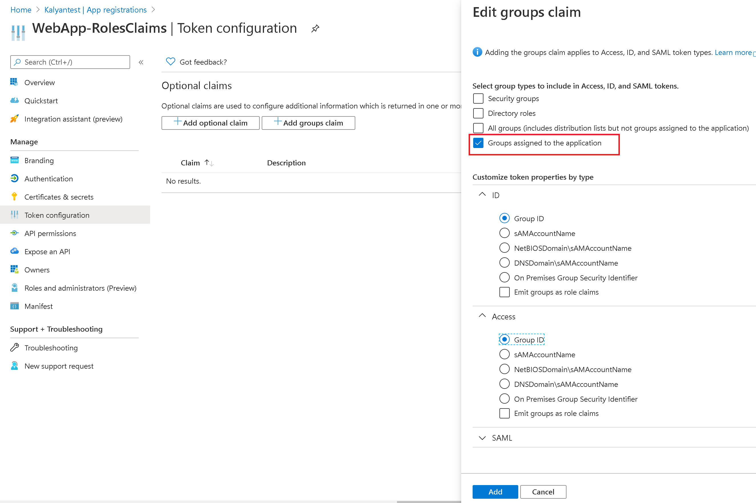
Application Groups - Configuration

Slide 42
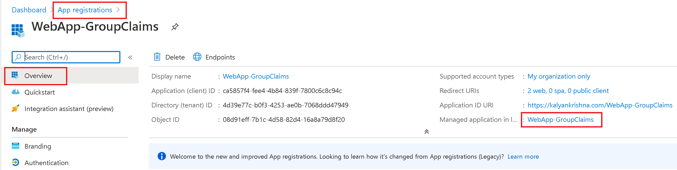
Application Groups – Assign groups

Slide 43
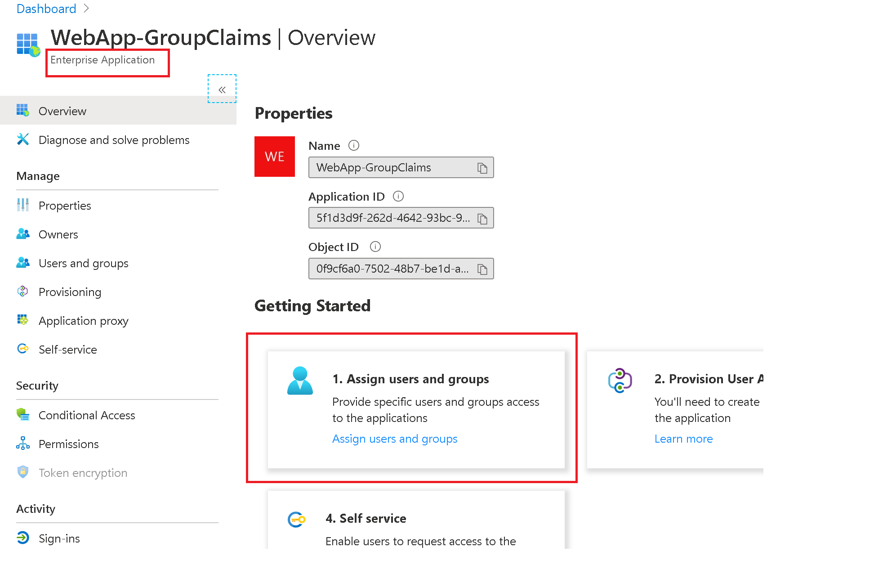
Application Groups – Assign groups

Slide 44
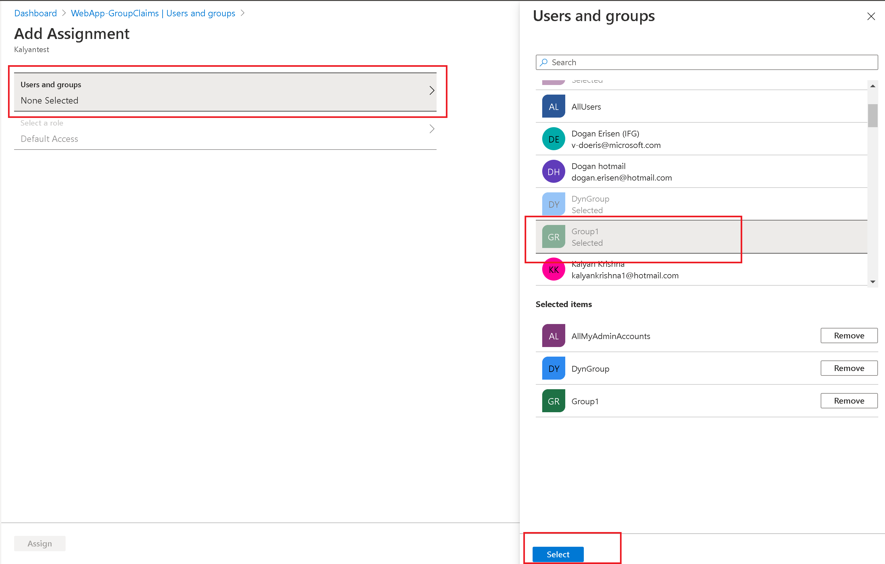
Application Groups – Assign groups

Slide 45
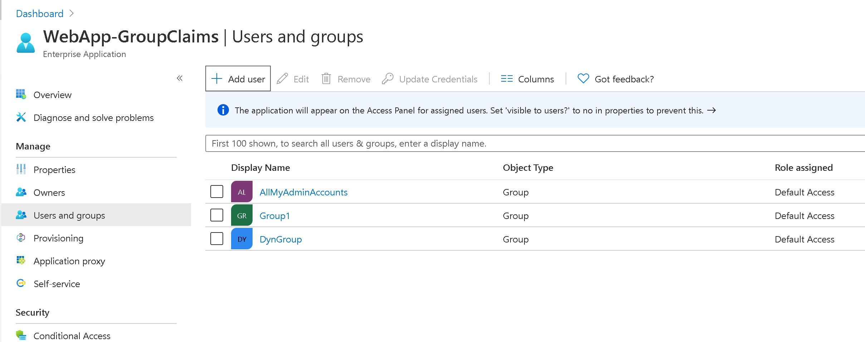
Application Groups – Assign groups

Slide 46
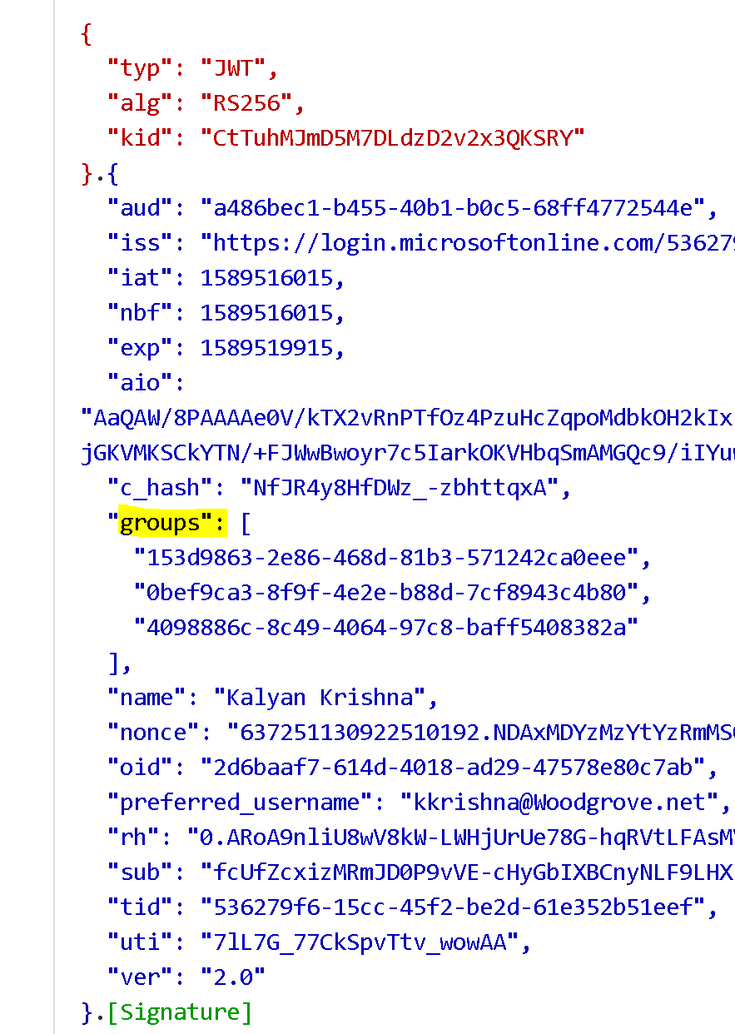
A token with assigned groups

Slide 47
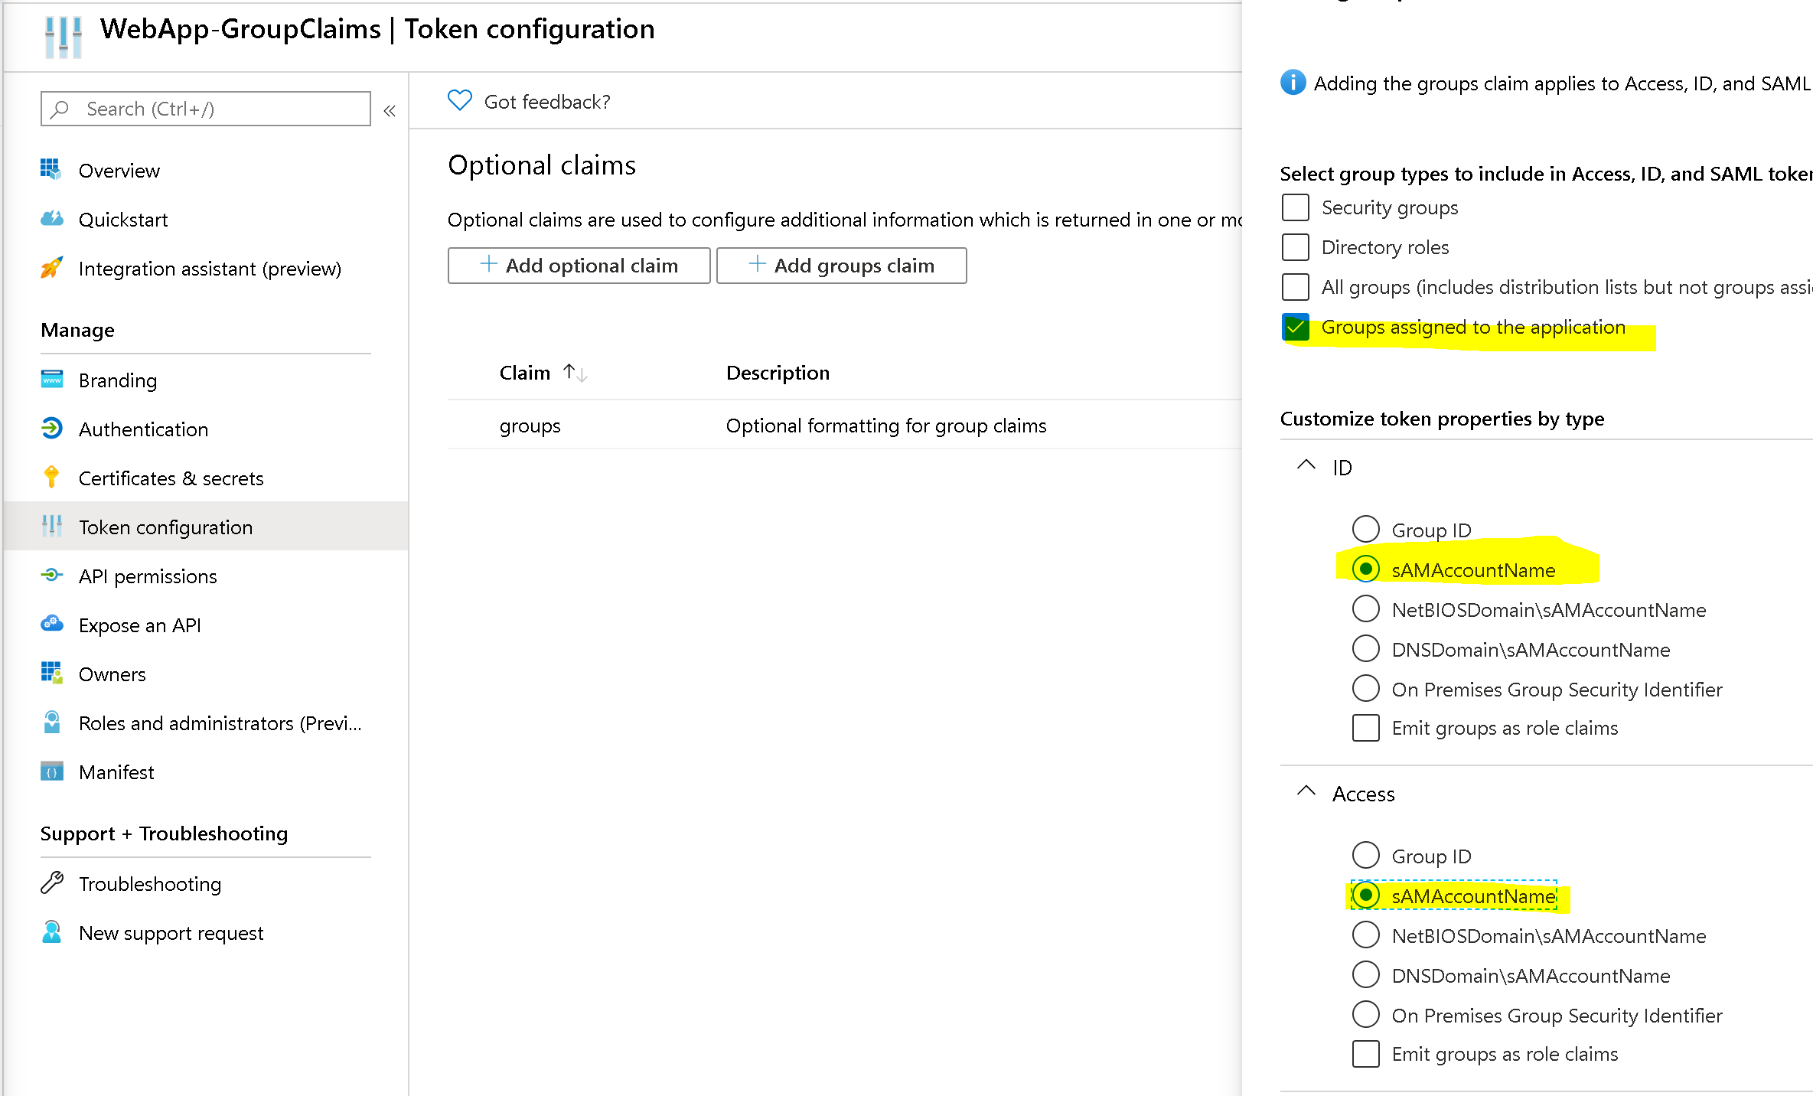
Application Groups – Get group name

Slide 48
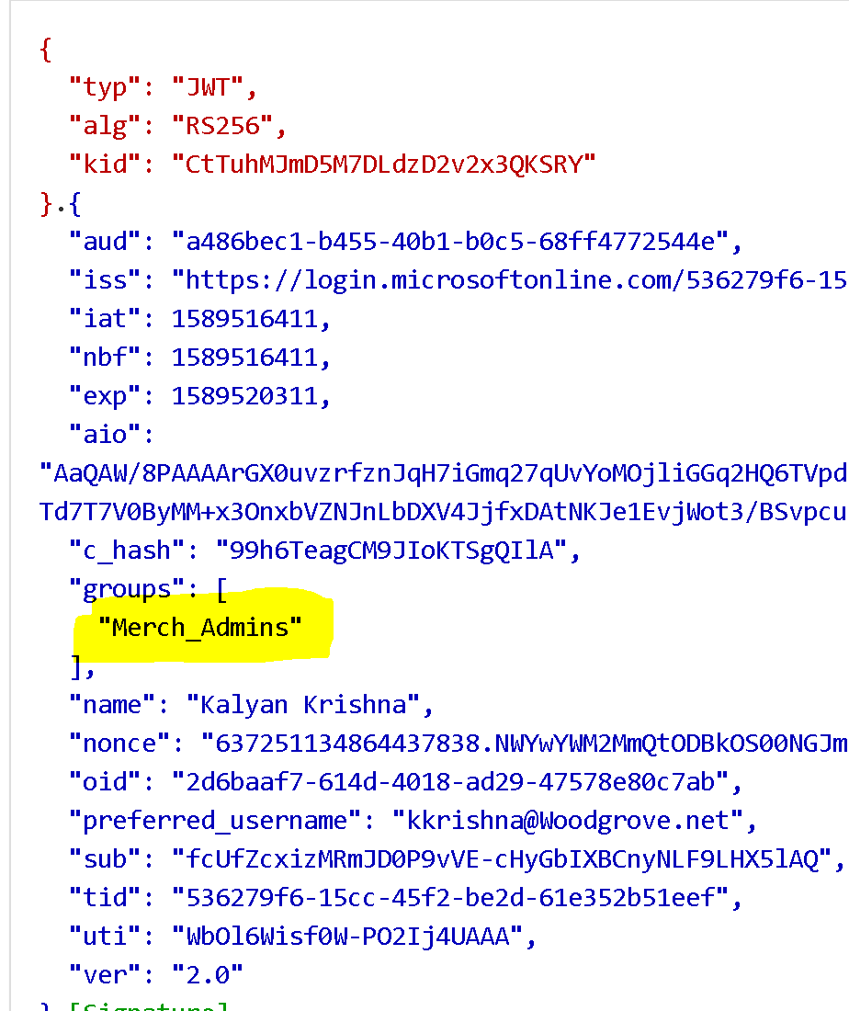
A token with assigned groups

Slide 49
Groups Overage

Slide 50
Groups overage claim
To ensure that the token size doesn’t exceed HTTP header size limits, Azure AD limits the number of Ids that it includes in the groups claim.
If a user is member of more groups than the overage limit (150 for SAML tokens, 200 for JWT tokens), then Azure AD does not emit the groups claim in the token.
Instead, it includes an overage claim in the token that indicates to the application to query the Graph API to retrieve the user’s group membership.

Slide 51
Token with overage Emitted when a user is member of more groups than the overage limit 200 for JWT tokens 150 for SAML tokens 6 for Implicit Flow
{
"aud": "19a7ff3f-24fd-40ba-884b-f00e00179fdf",
"iss": "https://login.microsoftonline.com/72f988bf-86f1-41af-91ab-2d7cd011db47/v2.0",
"iat": 1563966830,
"nbf": 1563966830,
"exp": 1563970730,
"_claim_names": {
"groups": "src1"
},
"_claim_sources": {
"src1": {
"endpoint": "https://graph.windows.net/72f988bf-86f1-41af-91ab-2d7cd011db47/users/32fe213d-e4d1-4973-96f9-1901ec32a16c/getMemberObjects"
}
},
"aio": "AWQAm/8MAAAG29wflVSWrAYPL8T",
"name": "Kalyan Krishna",
"oid": "32fe213d-e4d1-4973-96f9-1901ec32a16c",
"preferred_username": "kkrishna@microsoft.com",
"sub": "mPkIo6qb0M8qYT5ULpqXJscrKhWkz-FecFsRA4NeH8w",
"tid": "72f988bf-86f1-41af-91ab-2d7cd011db47",
"uti": "38iX3BfTa0S3IOKfdLoJAA",
"ver": "2.0"
}

Slide 52
Groups overage claim- Implicit flow
The overage indication and limits are different than the apps using other flows.
A claim named hasgroups with a value of true will be present in the token instead of the overage (_claim_names) claim .
The maximum number of groups provided in the groups claim is limited to 6 (six). This is done to prevent the URI fragment beyond the URL length limits.

Slide 53
Steps to process groups claim
Check for the claim _claim_names with one of the values being groups. This indicates overage.
If found, make a call to the endpoint specified in _claim_sources to fetch user’s groups.
This requires an access token for Graph with the User.Read and GroupMember.Read.All permissions to call getMemberObjects Api
If none found, look into the groups claim for user’s groups.

Slide 54
Groups overage
Consider using Application Roles to provide a layer of indirection between the group membership and the application. The application then makes internal authorization decisions based on role clams in the token.
Handing overage scenarios builds dependency on MS Graph, which requires additional effort on part of the developer

